Slide 1
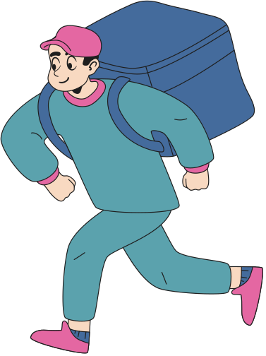
KhatKhat
Problem statement
In smaller cities like Goa, there is still no fast
and reliable infrastructure for urgent person-to-person deliveries
This gap creates daily friction for students, professionals, shop owners, hospitals, and local communities. The challenge is not just delivery — it is intelligent coordination in real time.
.

Slide 2
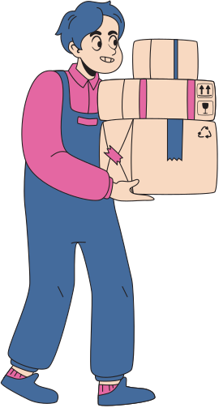
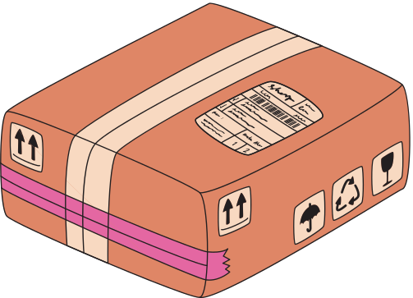
49 Raptors
Team Members
Waylen Barreto
Amey Kapdi
Geetesh Naik
Yash Bavkar

Slide 3
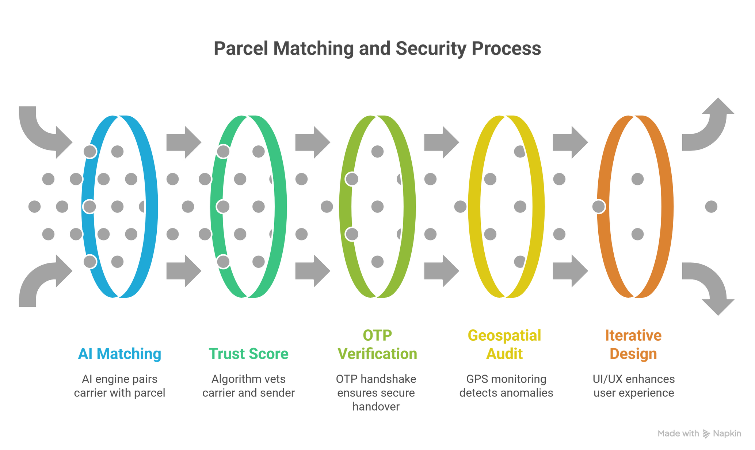

Our Approach

Slide 4
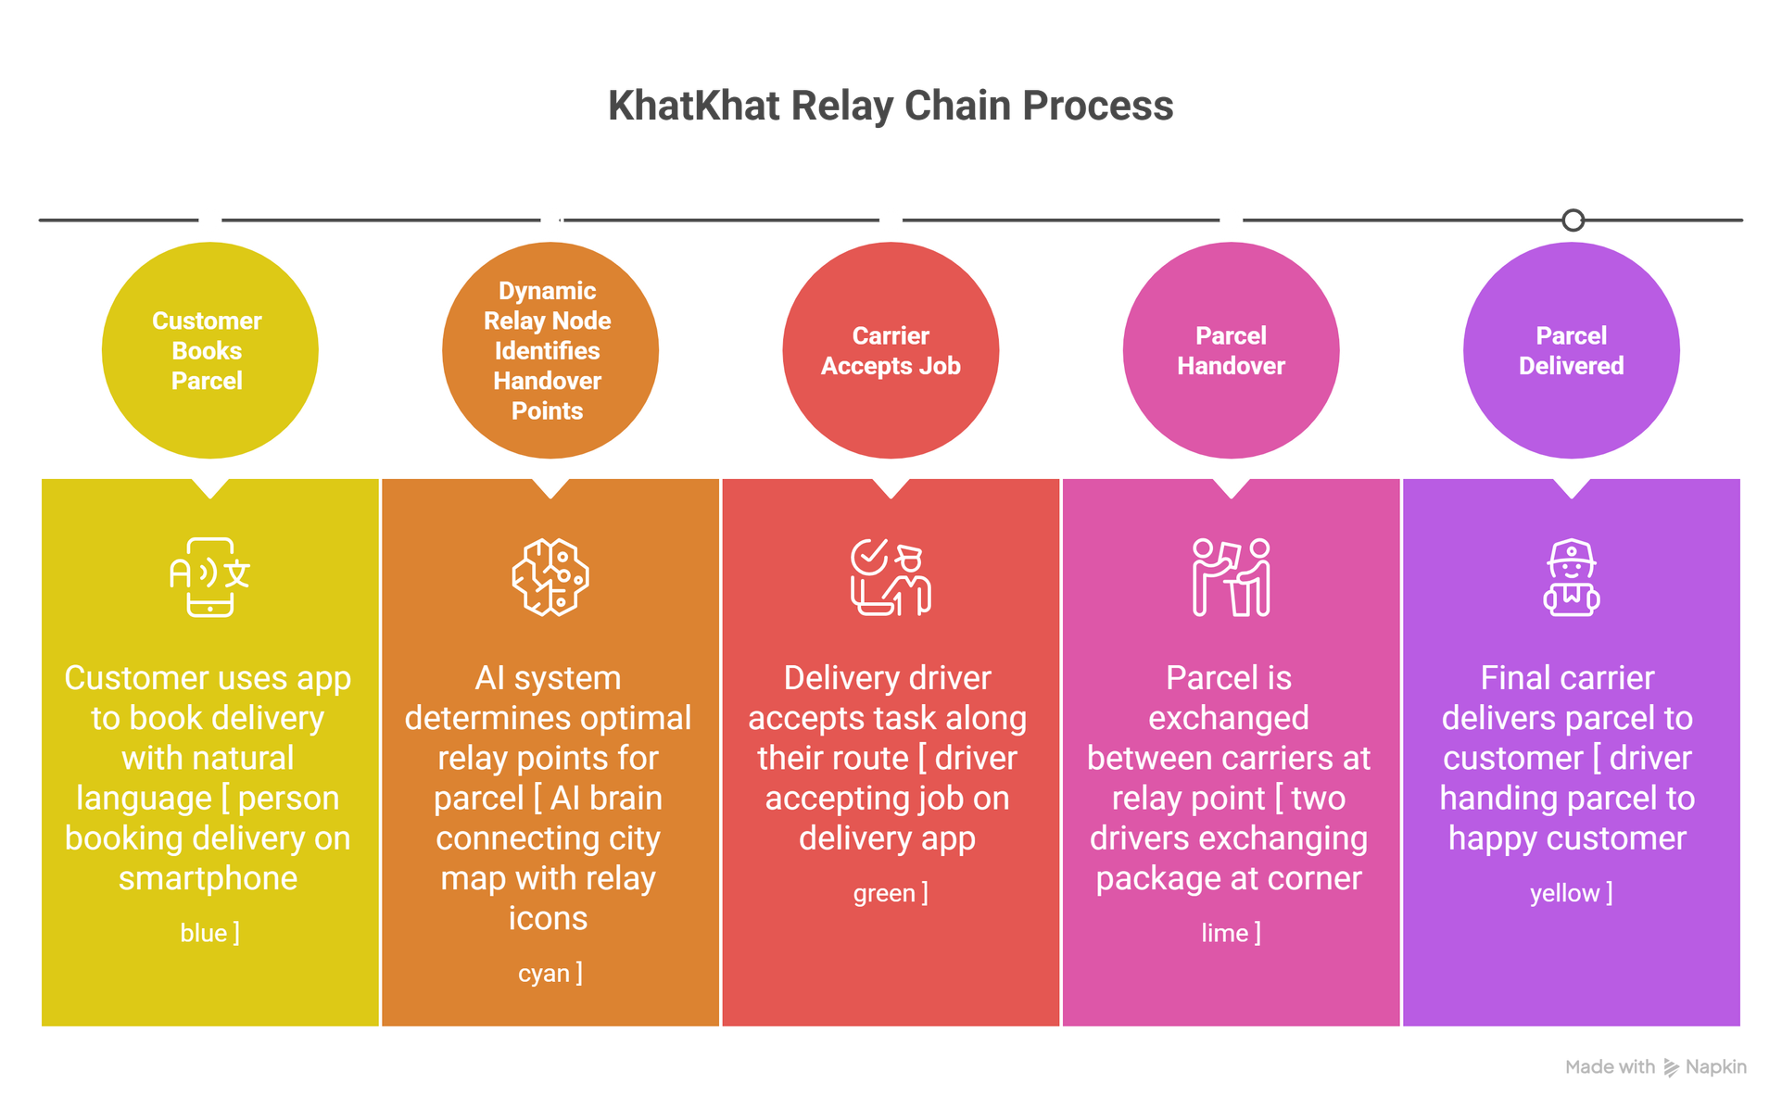
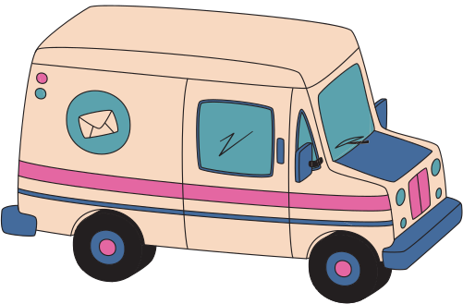
Proposed Solution

Slide 5
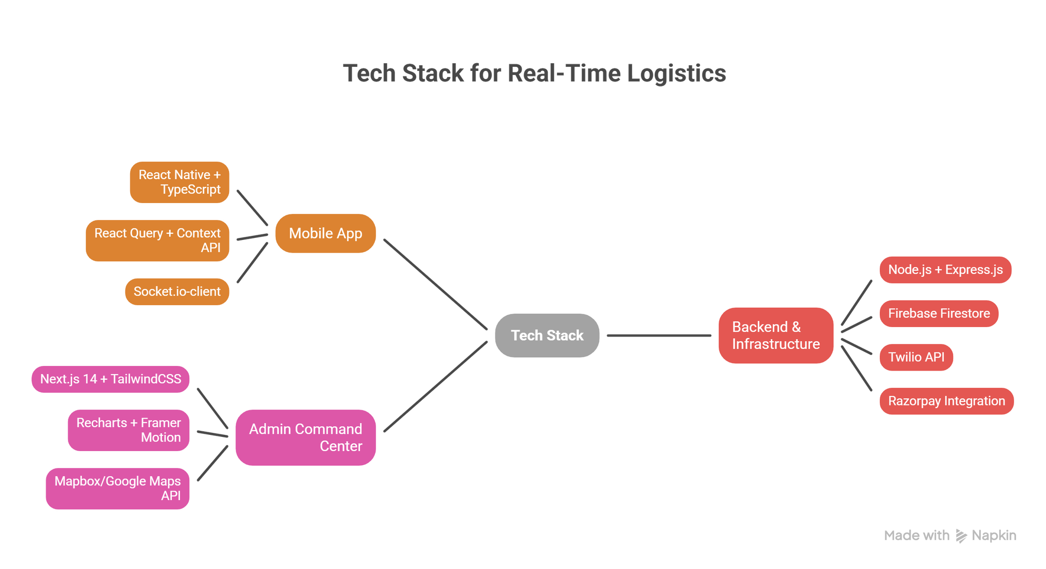
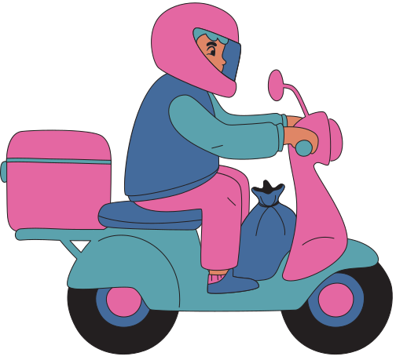
Techstack

Slide 6
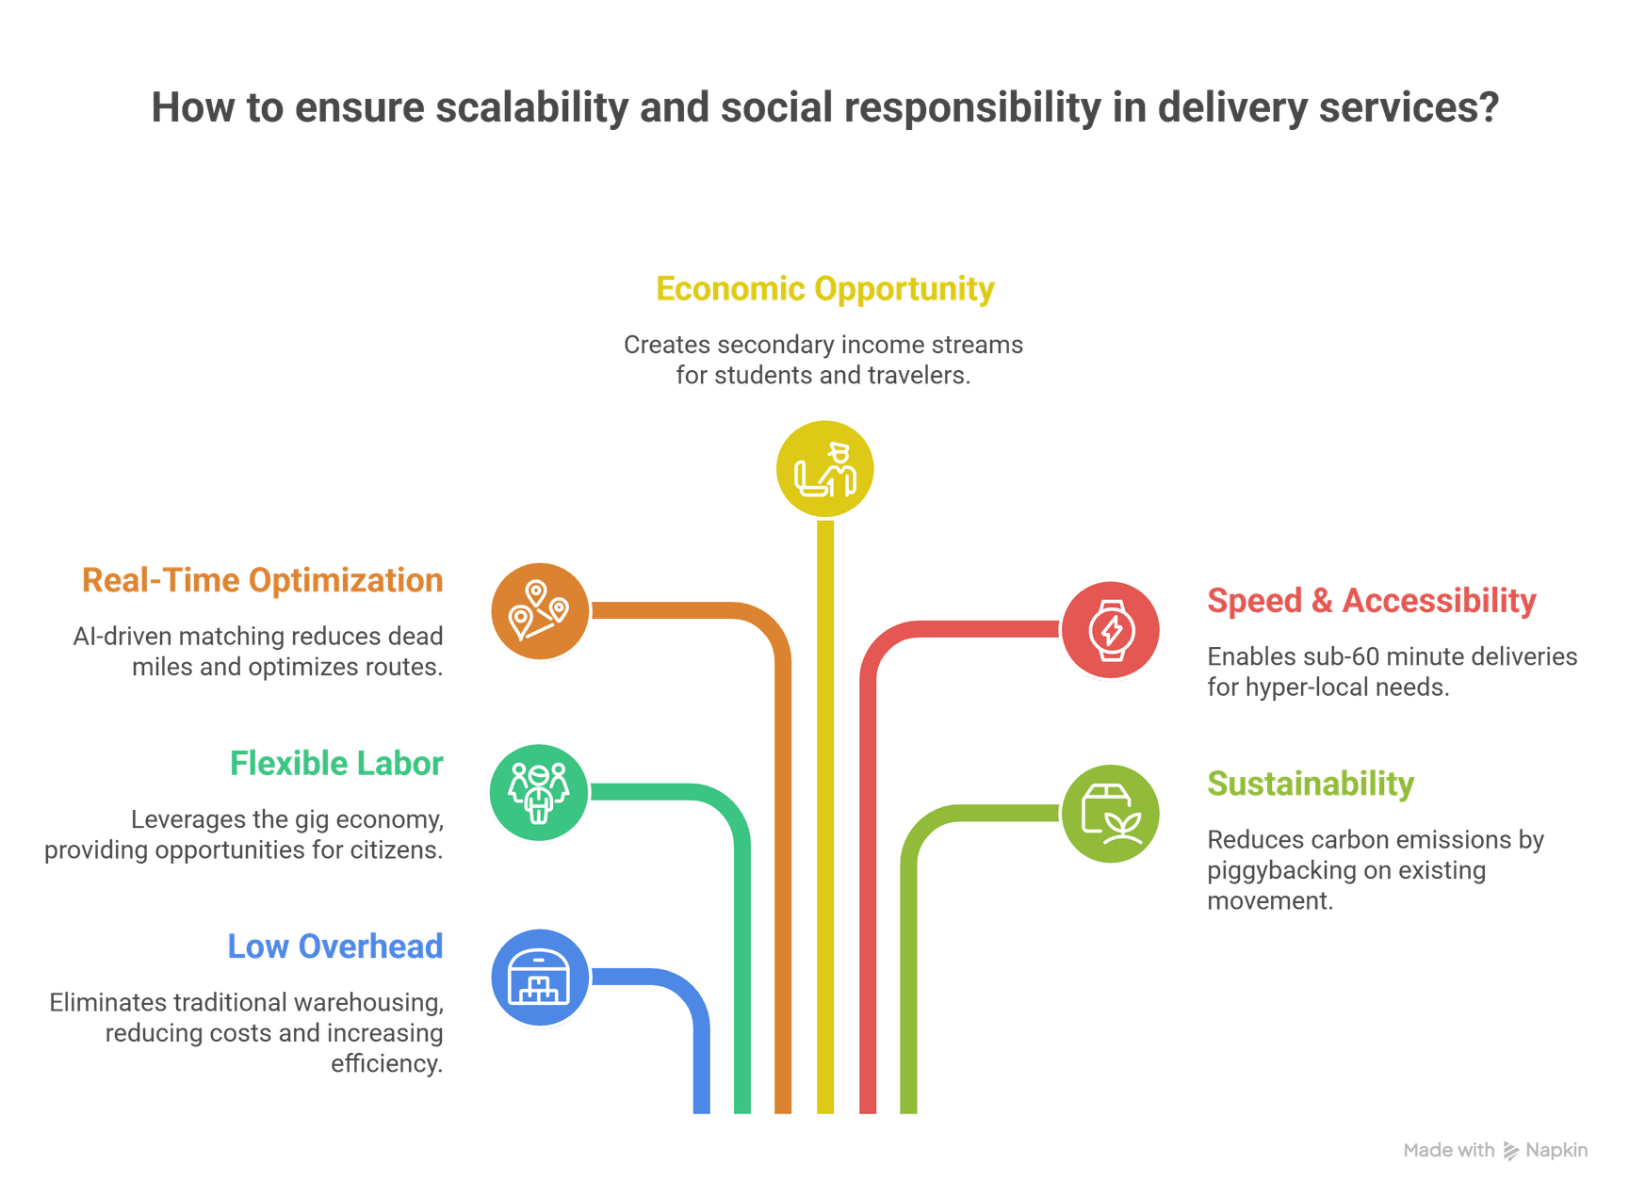
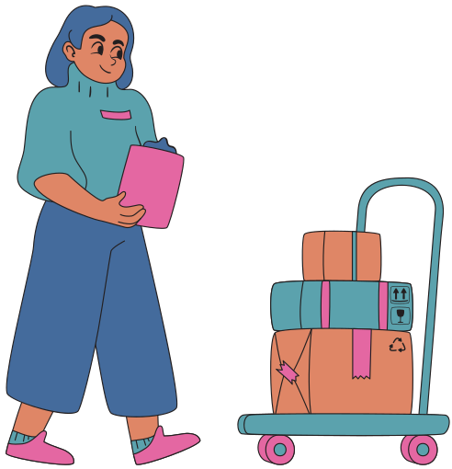
Impact & Feasibility

Slide 7
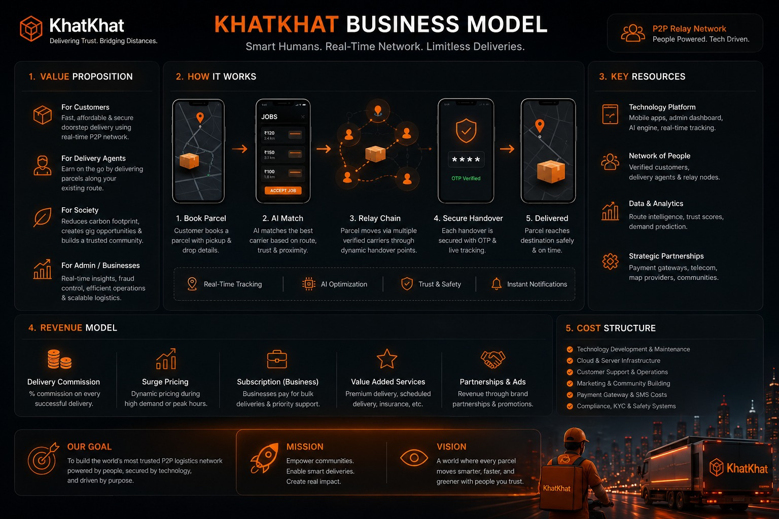

Business Model

Slide 8
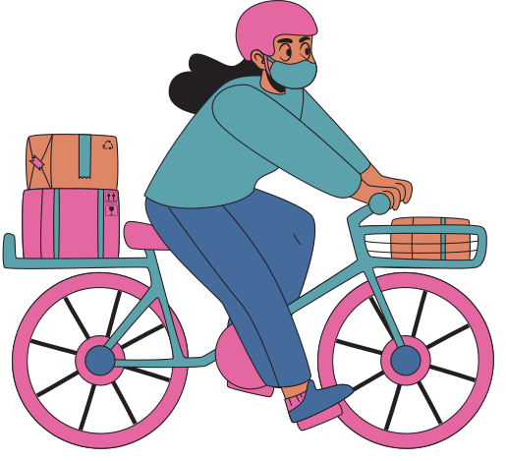
Thank You

